Slide 1
MSc Research Project Presentation
Seán Ó Fithcheallaigh
May 24, 2023
1/12

Slide 2
Agenda
Research background
Project work
Data collection
Machine Learning Analysis
Deep Learning Analysis
Deployment to Edge device
Evaluation
2/12

Slide 3
Project Background
As we live longer, more and more people are expected to develop visual impairments. Experts predict by 2050 the number of people suffering from sight loss will double to over 4 million [L. Pezzullo, 2018]
Having a visual impairment can have a serious impact on a person’s physical and mental health
Development and use of an Edge device for obstacle detection and navigation would allow the user to live a more full, independent life
L. Pezzullo, J. Streatfeild, P. Simkiss and D. Shickle, ”The economic impact of sight loss and blindness in the UK adult population,” BMC Health Services Research, vol. 18, 2018.

Slide 4
Project Background
As we live longer, more and more people are expected to develop visual impairments
Having a visual impairment can have a serious impact on a person’s physical and mental health
Development and use of an Edge device for obstacle detection and navigation would allow the user to live a more full, independent life

Slide 5
Aims and Objectives
Develop a system for obstacle detection and localisation in an indoor setting to allow navigation of an unfamiliar setting by people with visual impairments

Slide 6
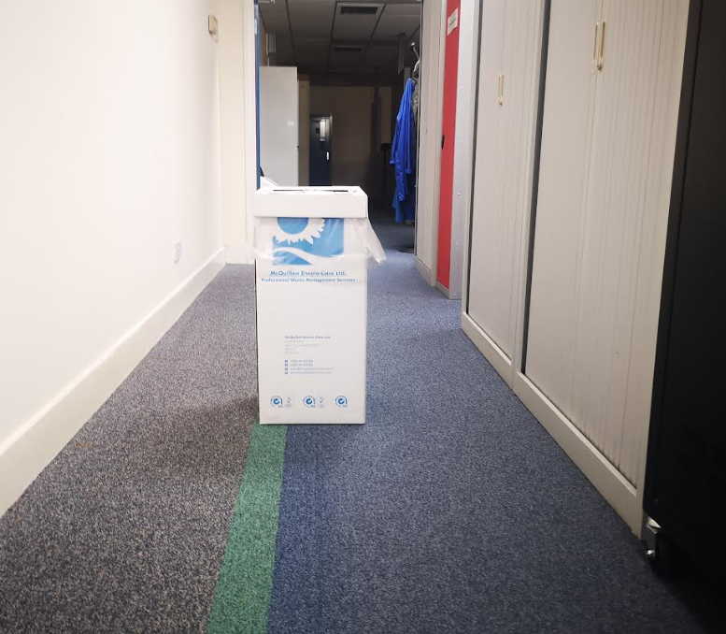
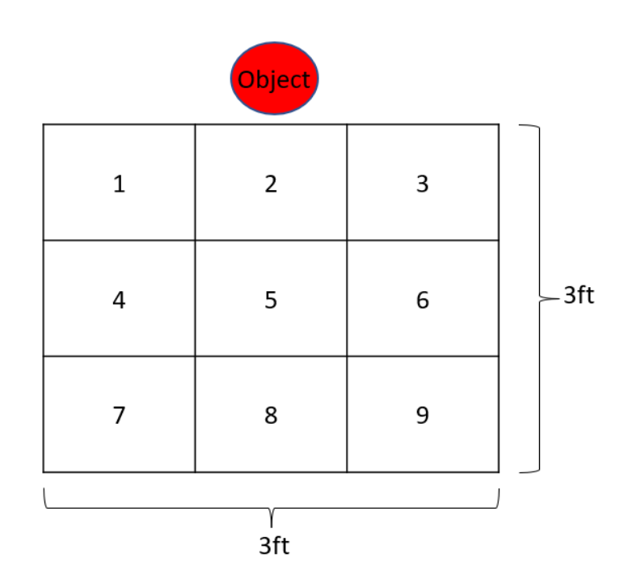
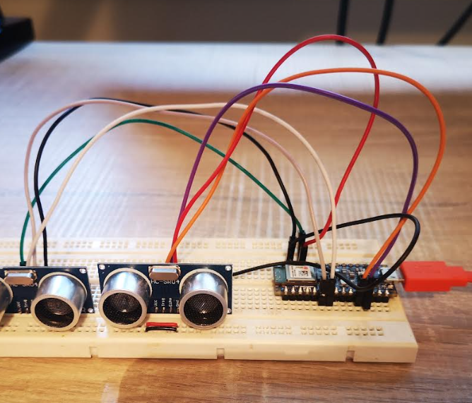
Project Work: Data Collection
Data was collected using an Arduino Development Kit using 2 ultrasonic sensors, coded using the Arduino IDE
Objects were placed in the centre of a hallway
Data was collected from each grid location of a 3 by 3 grid
5/12

Slide 7
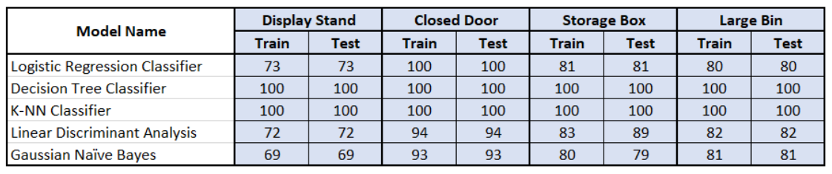
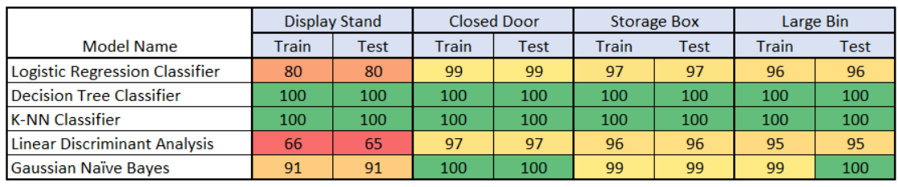
Analysis: Machine Learning
This analysis aims to answer the question: Can we use machine learning techniques to classify the data?
Data processed through a number of classification algorithms for a “binary search”, and a “grid search”
Binary Search
Results
Grid Search
Results
6/12

Slide 8
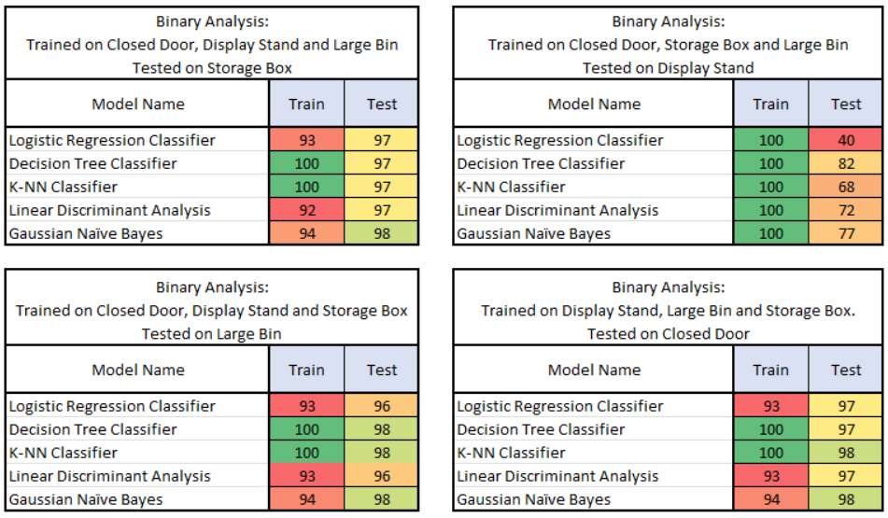
Analysis: Machine Learning
With the Decision Tree and K-Nearest Neighbour showing 100% accuracy, I wanted to dig deeper into these results
7/12

Slide 9
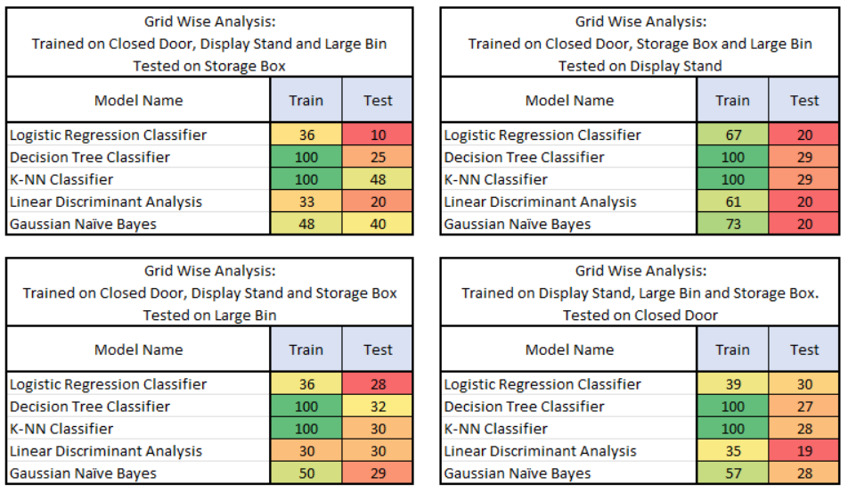
Analysis: Machine Learning
With the Decision Tree and K-Nearest Neighbour showing 100% accuracy, I wanted to dig deeper into these results
8/12

Slide 10
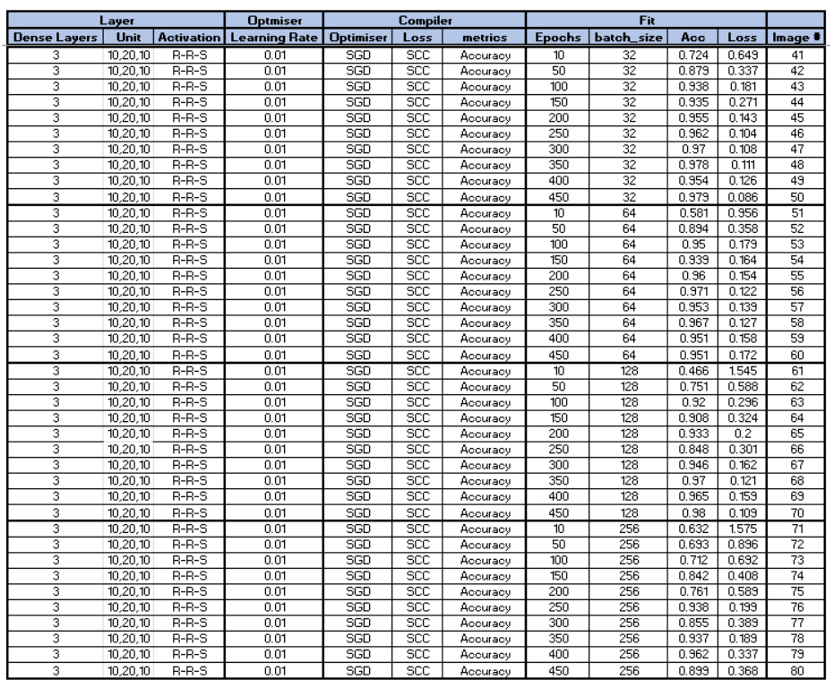
Analysis: Neural Networks
Neural networks built using the Keras framework from TensorFlow
Hyperparameters of a Dense network were tuned for the best Accuracy and Loss results:
Number of layers and neurons
Learning rate
Batch size
Epochs
Optimisers
9/12

Slide 11
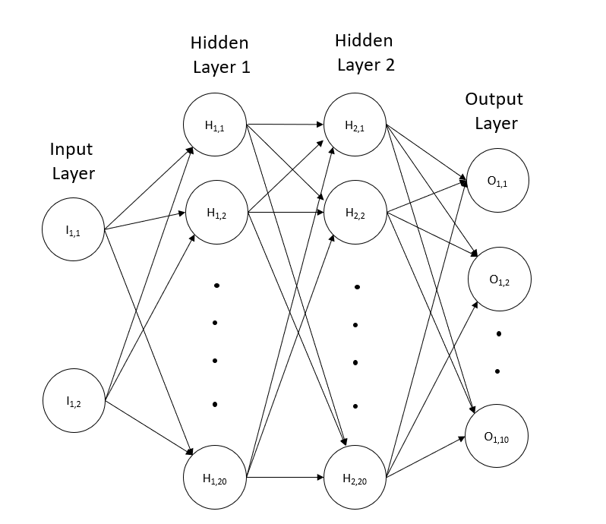

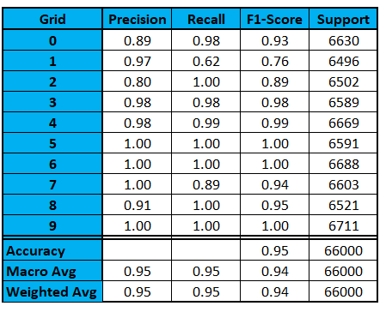
Analysis: Neural Networks

Slide 12
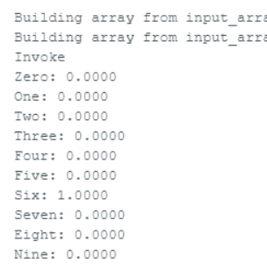
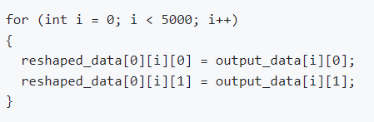
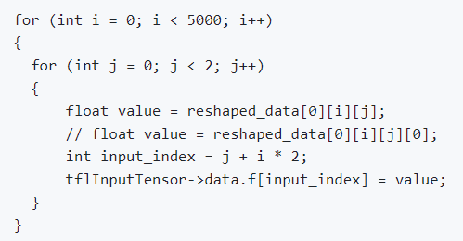
Deployment onto Constrained Device
Neural network was converted to a header file using TensorFlow
This header file can be imported into the microcontroller to be used with TensorFlow Lite
Initial tests did not produce an output from the inference
Investigations pointed towards the shape of the data being given to the input tensor was wrong
Modifications were made to both the sensor shape and the data being fed into the tensor
The system started to produce results, but it was always the same few grids no matter the data fed into the system
11/12

Slide 13
Conclusions and Future Work
A large dataset was created, using a number of obstacles
Initial analysis indicated that detecting obstacles is possible, but standard machine-learning techniques alone were not sufficient
Development of neural network proved promising with good accuracy scores
Deploying the model onto the constrained device generated a number of challenges, which have not been fully overcome
If these challenges could be overcome, this work has shown the potential to develop a system which could be used by people with visual impairments to navigate an unfamiliar indoor environment
12/12

